Slide 1
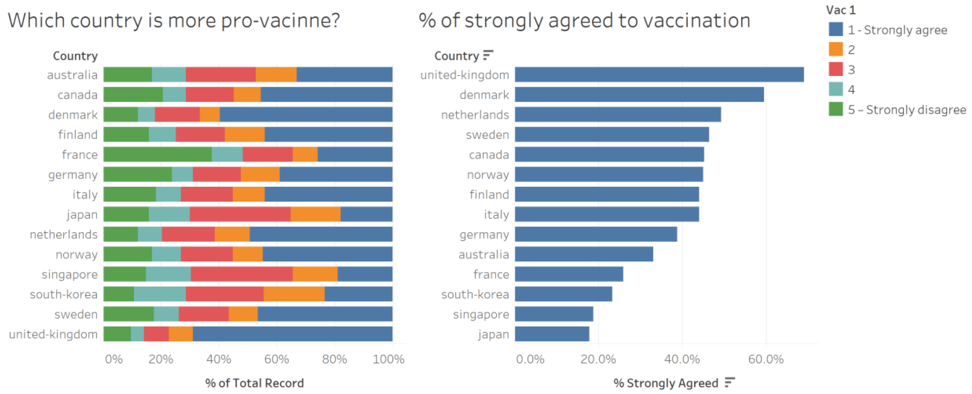
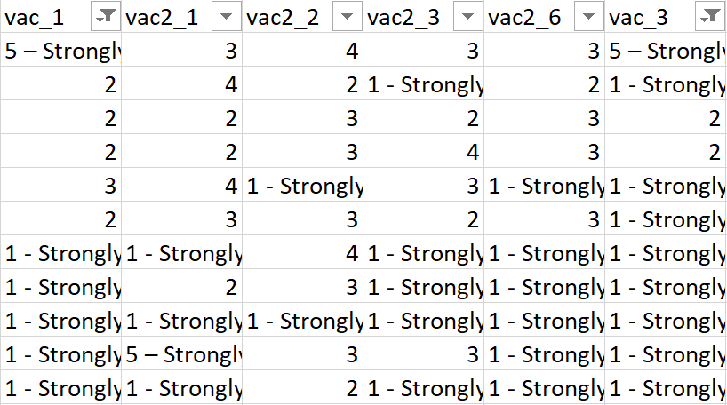
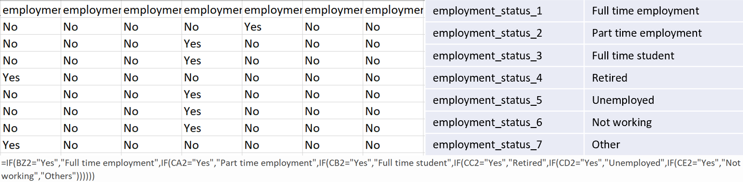
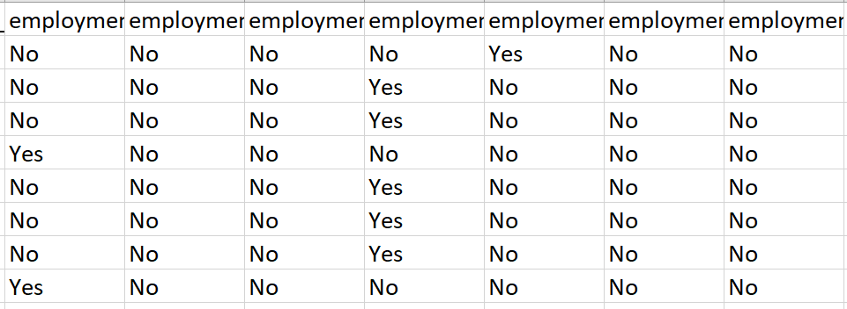
employment_status_1 | Full time employment
employment_status_2 | Part time employment
employment_status_3 | Full time student
employment_status_4 | Retired
employment_status_5 | Unemployed
employment_status_6 | Not working
employment_status_7 | Other

Slide 2
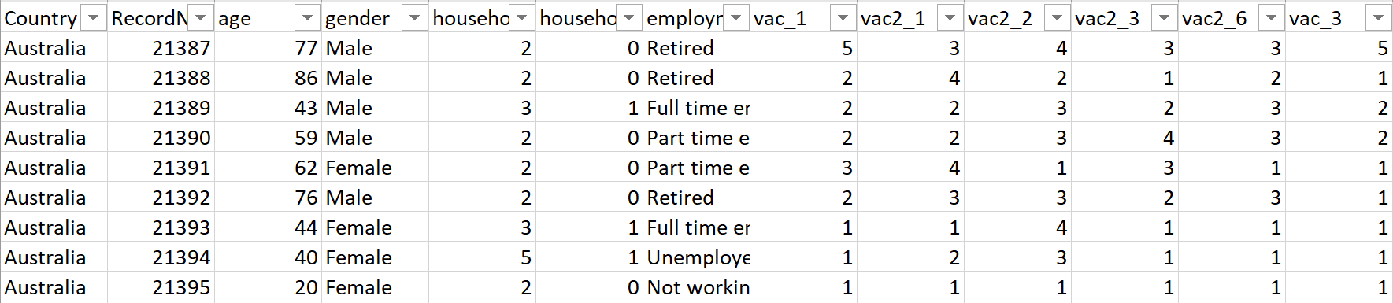
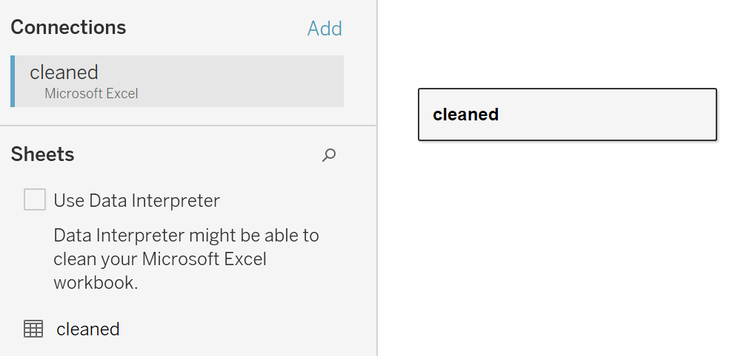
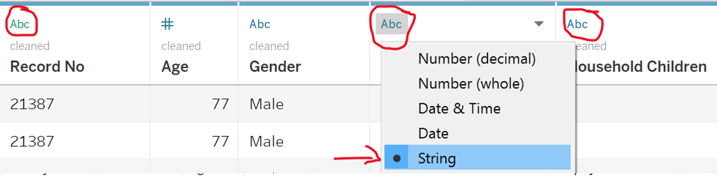
Git Clone
Clean data and collate in one file (alternatively create union in Tableau)
Data files with survey responses and attributes (including Spain)
Get rows with survey responses
Add column “Country” to identify
Merge employment status columns into one (Denmark, Finland, Norway, Sweden)
Rename values under employment_status
Rename “1 – Strongly agree” with “1”, “5 – Strongly disagree” with “5” to build diverging stacked bar chart
Rename “8” with “8 or more” under household_size
Rename “5”, “6”, “7”, “8” with “5 or more”, “Don’t know” with “Prefer not to say” under household_children

Slide 3
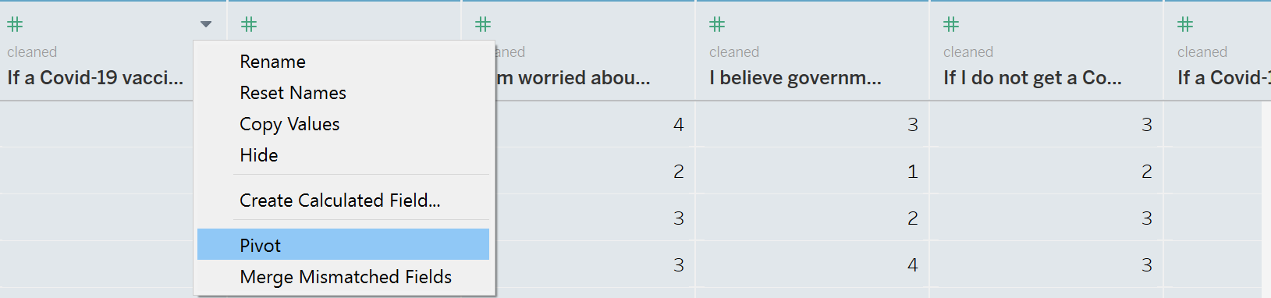
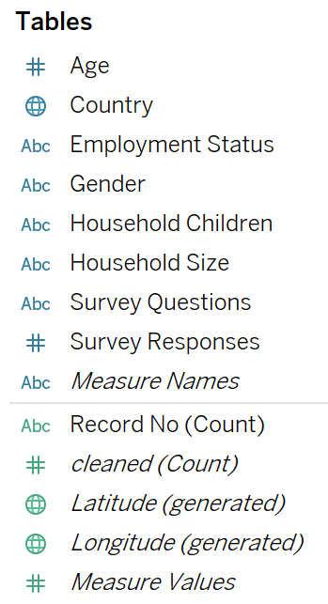
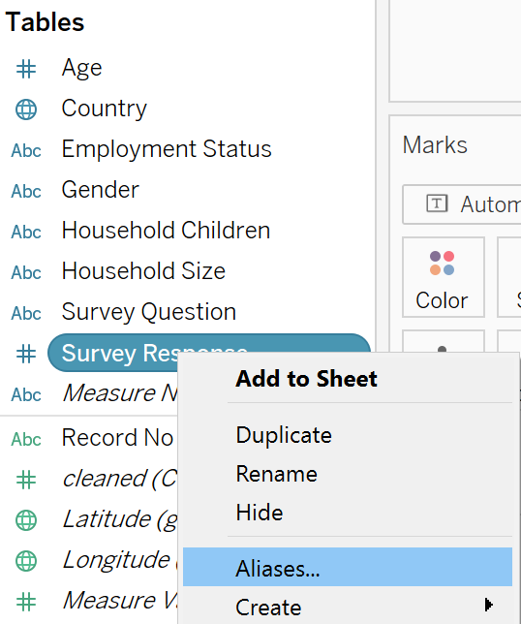
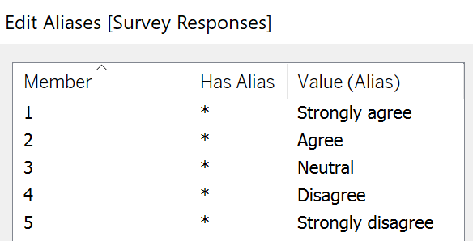
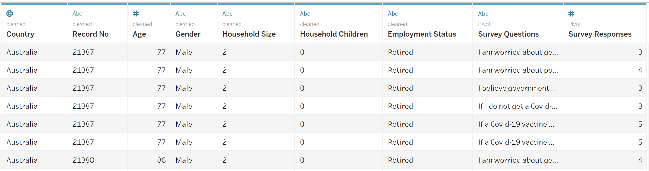
Save as cleaned.xlsx, Import into Tableau
Change data type of Record No, Household Size, Household Children to String
Rename vac_1, vac2_1, vac2_2, vac2_3, vac2_6, vac_3 to survey questions, pivot
Rename columns to Survey Question, Survey Response
Age, Country, Employment Status, Gender, Household Children, Household Size, Survey Questions, Survey Responses should be under dimensions
Edit aliases for Survey Responses
vac_1 | If a Covid-19 vaccine were made available to me this week, I would definitely get it
vac2_1 | I am worried about getting Covid-19
vac2_2 | I am worried about potential side effects of a Covid-19 vaccine
vac2_3 | I believe government health authorities in my country will provide me with an effective Covid-19 vaccine
vac2_6 | If I do not get a Covid-19 vaccine when it is available, I will regret it
vac_3 | If a Covid-19 vaccine becomes available to me in 2021, I definitely intend to get it

Slide 4
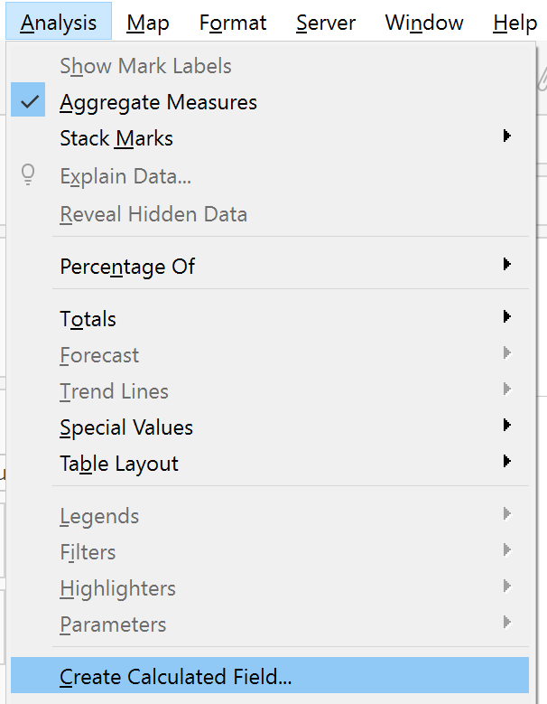
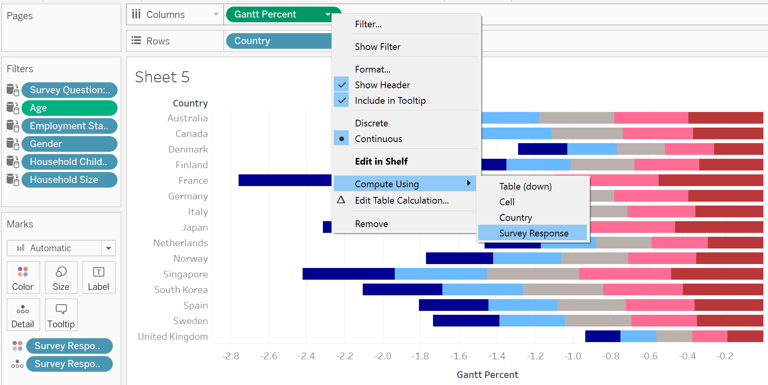
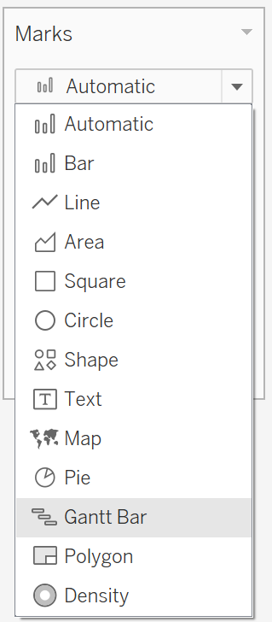
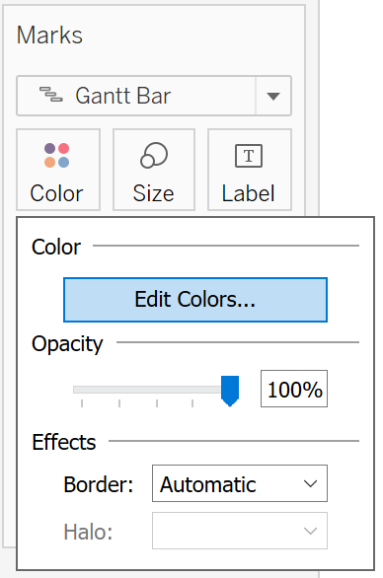
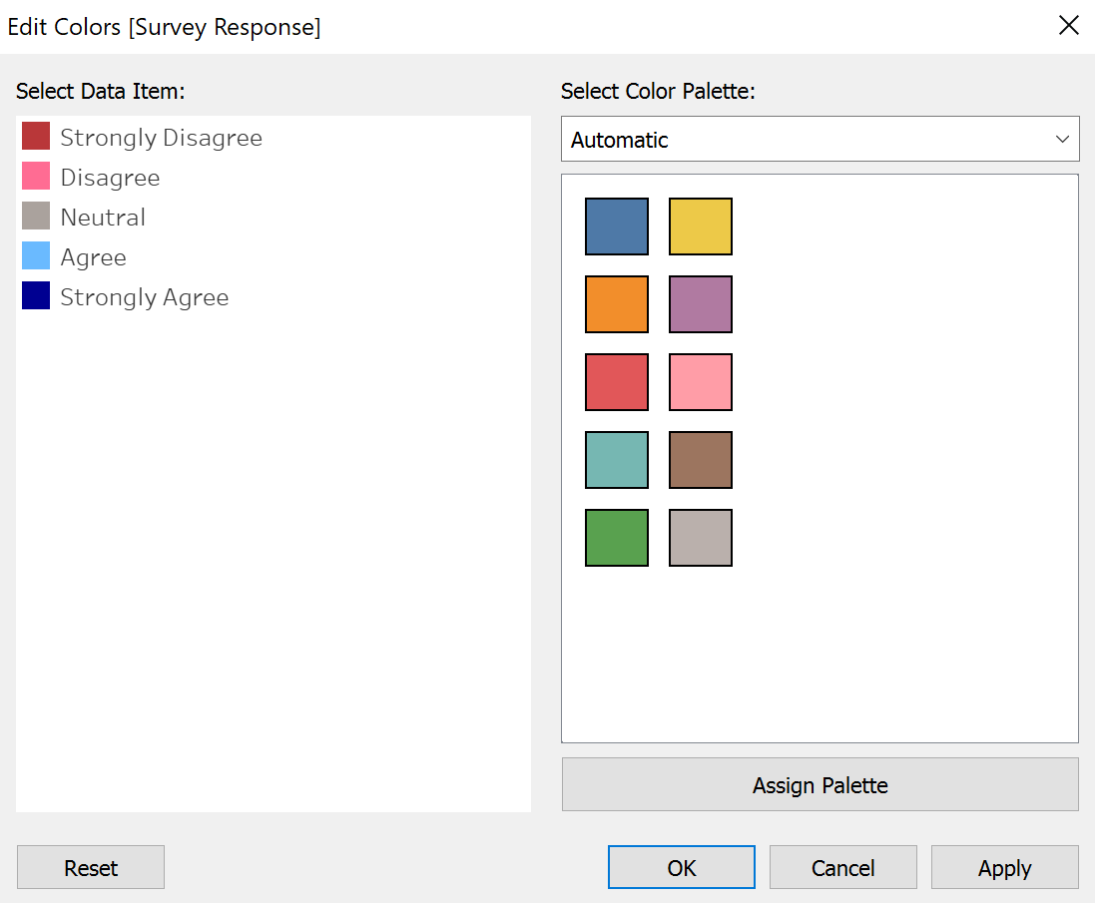
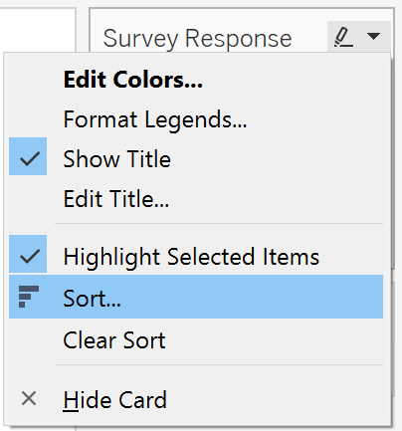
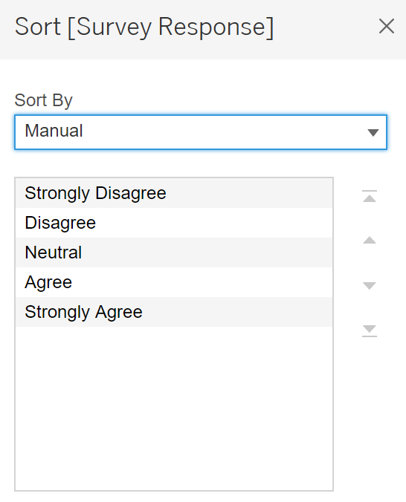

Slide 5
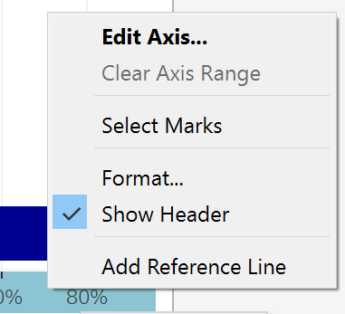
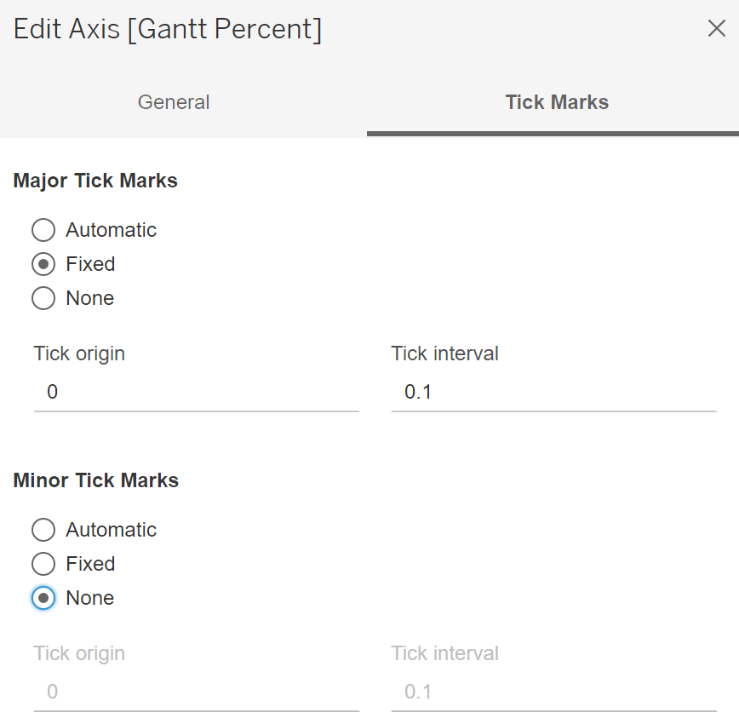
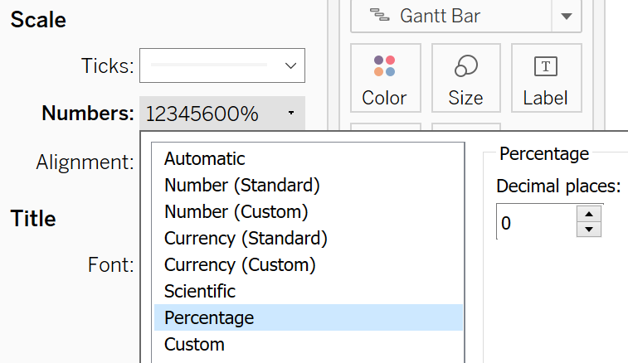
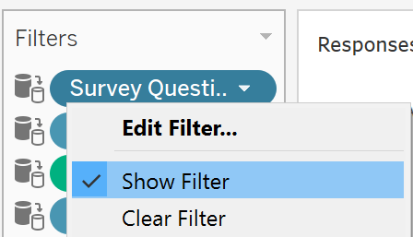
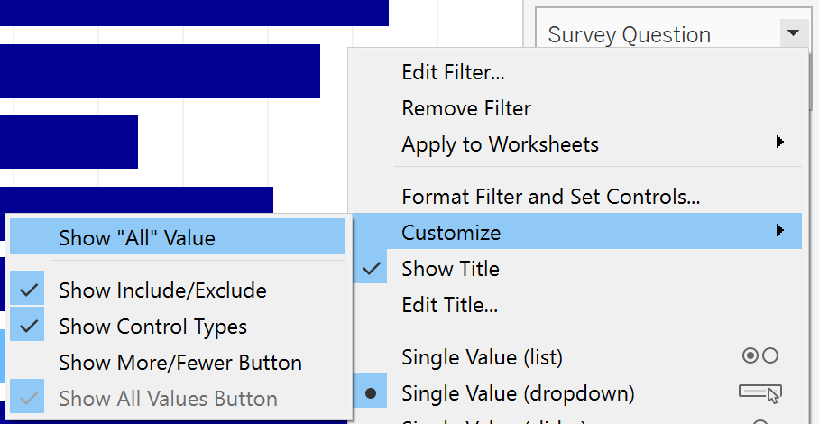
Diverging stacked bar chart
Create calculated fields
Number of Records: 1
Total Count: TOTAL(SUM([Number of Records]))
Count Negative i.e. >3 (strongly disagree/disagree)
IF [Survey Response]>3 THEN 1
ELSEIF [Survey Response]=3 THEN 0.5
ELSE 0
END
Total Count Negative : TOTAL(SUM([Count Negative]))
Percentage: SUM([Number of Records])/[Total Count]
Gantt Start: -[Total Count Negative]/[Total Count]
Gantt Percent: PREVIOUS_VALUE([Gantt Start])+ZN(LOOKUP([Percentage],-1))
Survey Response under Detail/Colour
Gantt Percent under Columns, Compute Using Survey Response
Country under Rows
Change to Gantt Bar
Percentage under Size
Edit Colour for Survey Response
Good practice to view negative on left and positive on right
Manual Sort Survey Response
Format axis for Gantt Percent to Percentage with 0 decimal place, edit tick marks
Survey Question (Single Value Dropdown) under Filters
Show Filter, Survey Question (Customize and not show All)

Slide 6
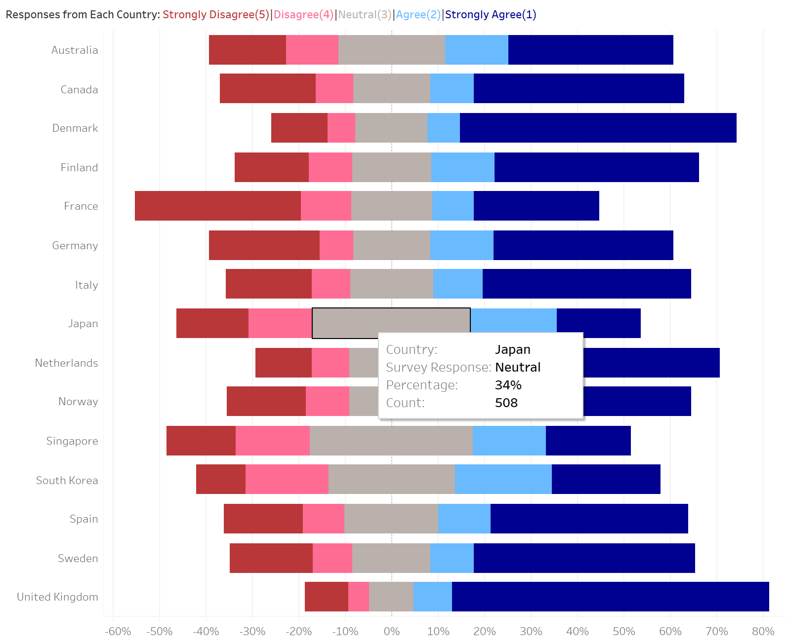
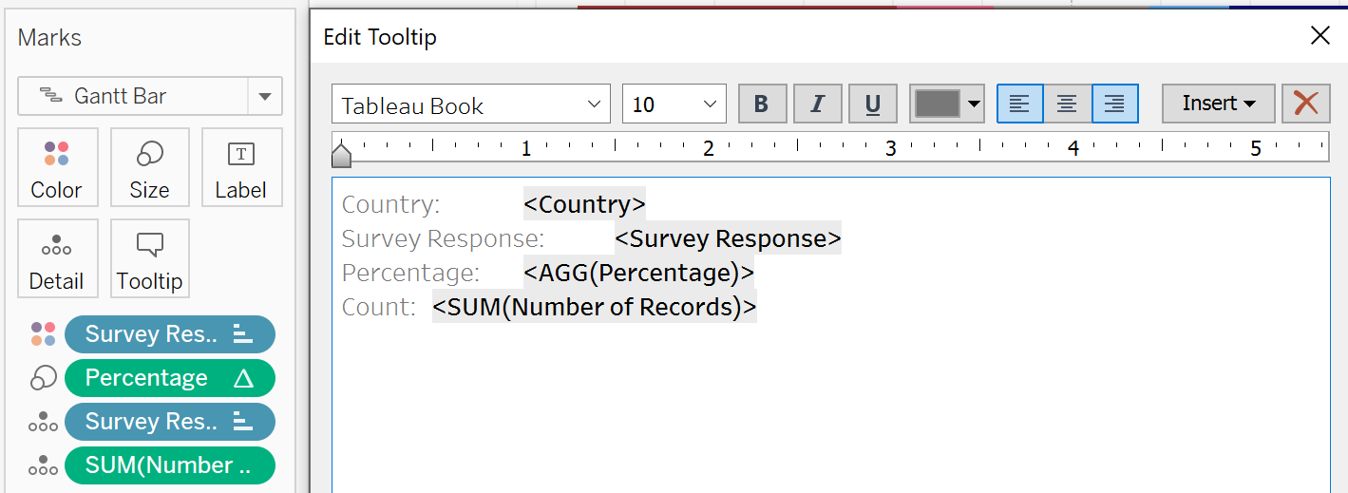
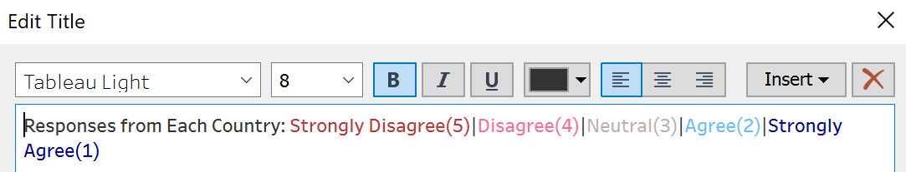
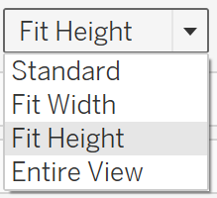
Number of Records under Detail
Edit Tooltip
Edit Title: Responses from Each Country
Adjust graph to fit height

Slide 7
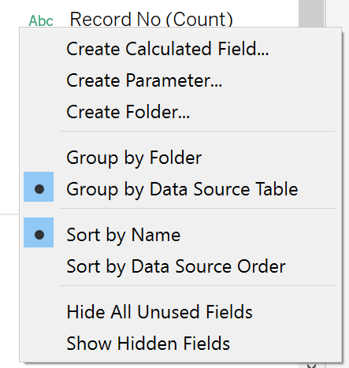
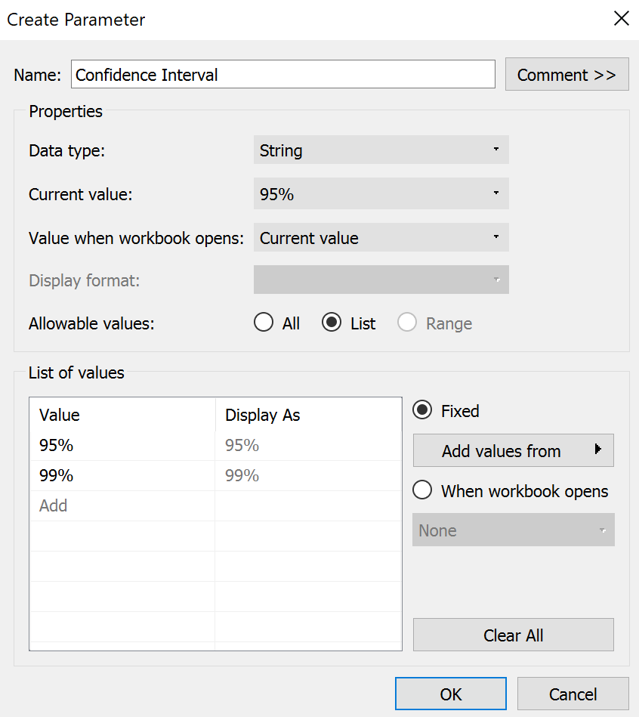
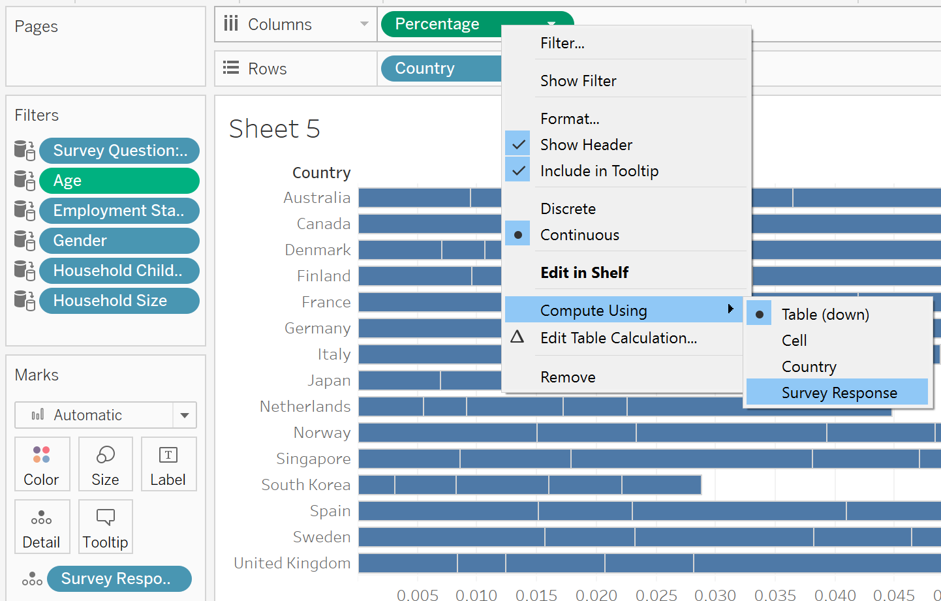
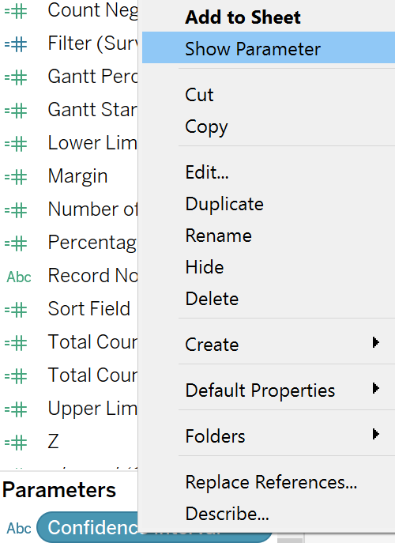
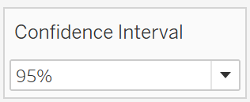
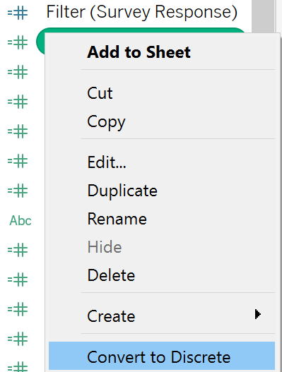
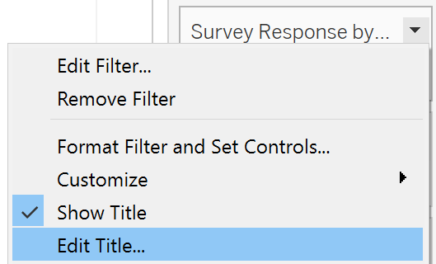
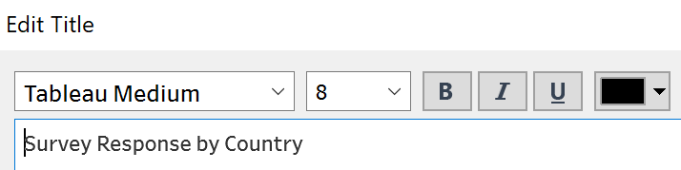

Slide 8
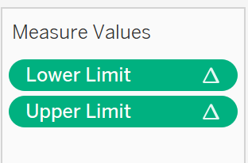
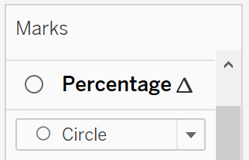
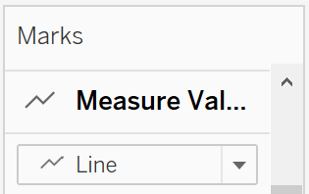
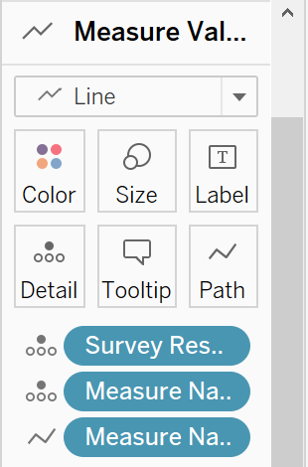
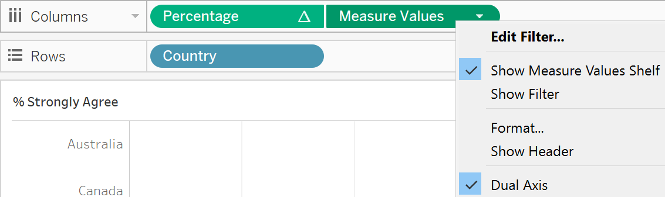
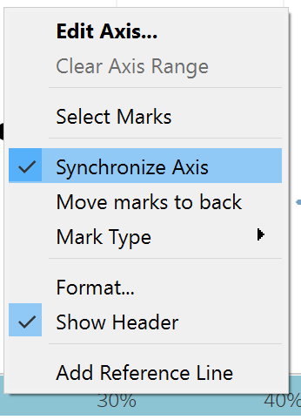
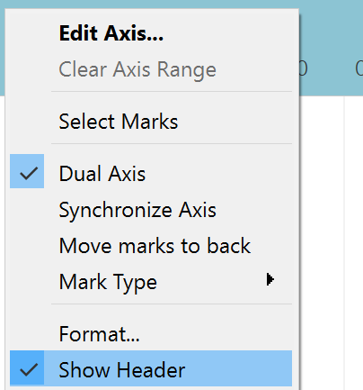
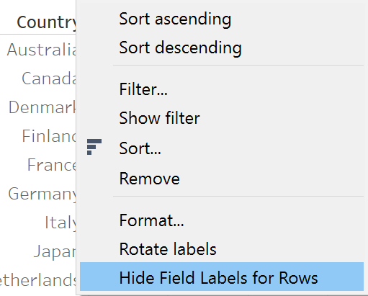
Dot plot with error bars
Assume normal distribution
Create Parameter: Confidence Interval
Create calculated field
Z
IF [Confidence Interval]="95%" THEN 1.959964
ELSEIF [Confidence Interval]="99%" THEN 2.575829
END
Margin: [Z]*SQRT(([Percentage]*(1-[Percentage]))/[Total Count])
Upper Limit: [Percentage]+[Margin]
Lower Limit: [Percentage]-[Margin]
Country under Rows
Survey Response under Detail
Percentage under Columns, Compute Using Survey Response
Create calculated field
Filter (Survey Response): LOOKUP(ATTR([Survey Responses]), 0) i.e. filter without changing percentage, Convert to Discrete
Survey Question, Filter (Survey Response) under Filters
Show Filter, Single Value Dropdown, Edit Title to Survey Response
Customize and not show All

Slide 9
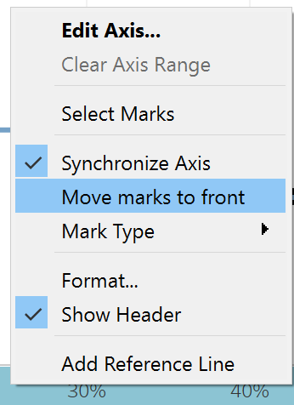
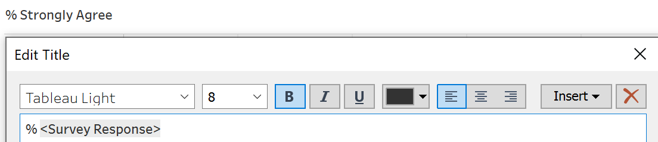
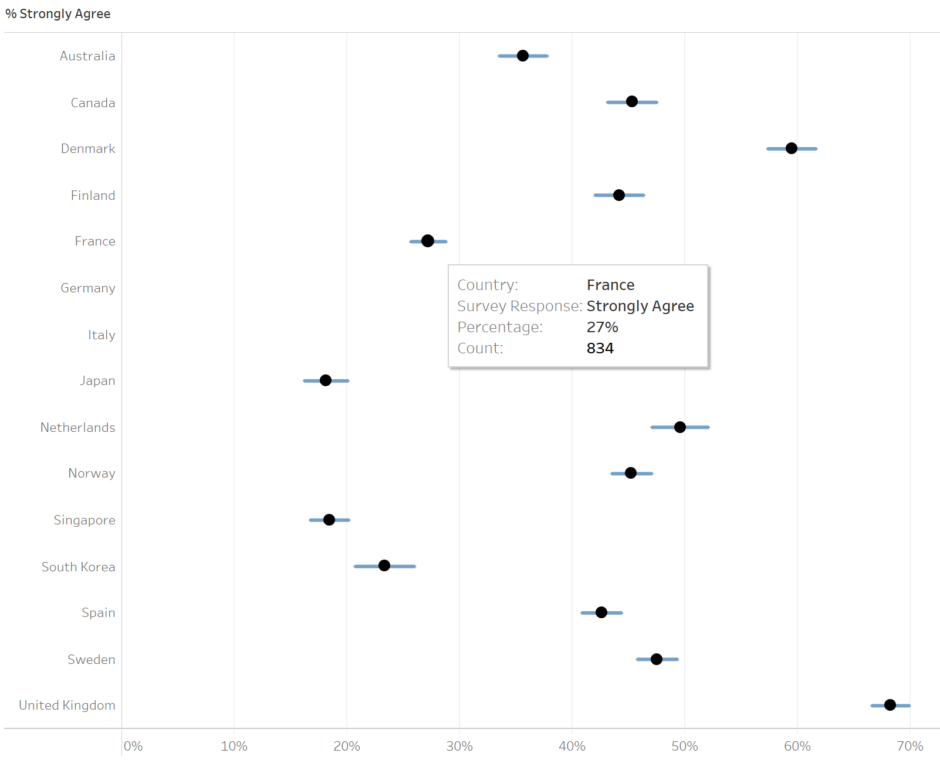
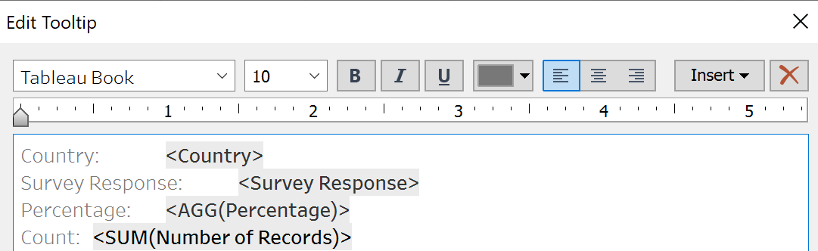
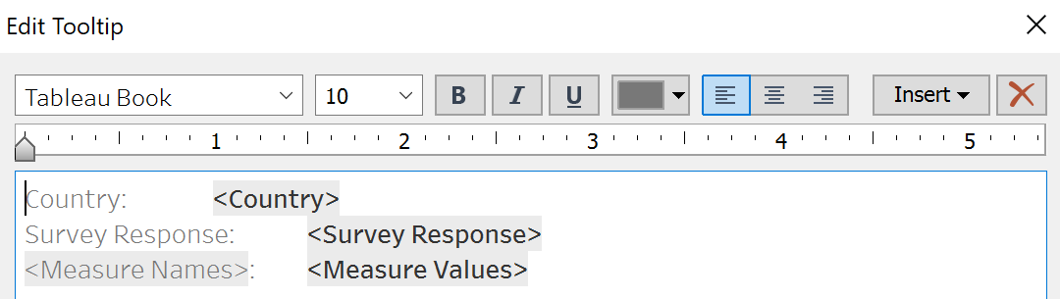
Measure Values under Columns, Keep only Lower Limit & Upper Limit
Format Lower Limit & Upper Limit to Percentage with 0 decimal place
Change Percentage to Circle Chart
Change Measure Values to Line Chart
Measure Names under Path
Dual/Synchronise Axis, Hide “Value” Axis for Measure Values
Right click Percentage Axis, move marks to front
Format axis for Percentage to Percentage with 0 decimal place, edit tick marks
Edit Tooltip
Edit Title: % <Survey Response>
Adjust graph to fit height
Change Colour, Percentage (Black), Measure Values (Light Blue)
Percentage
Measure Values

Slide 10
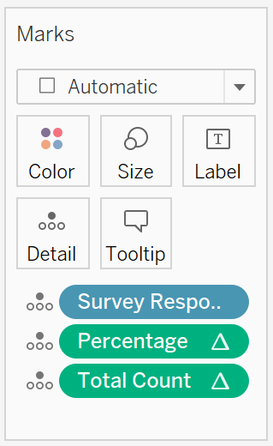

Title
Survey Response, Percentage, Total Count under Detail
Survey Question, Filter (Survey Response) under Filters
Show Filter, Single Value Dropdown, Edit Title to Survey Response
Customize and not show All
Edit Title: <Survey Question>
<AGG(Percentage)> of <AGG(Total Count)> Survey Respondents <Survey Response> to This Statement

Slide 11



Breakdown
Create Parameter: Demographic
Exclude Age, as it’s continuous variable
Create calculated field: Demographic
IF [Parameters].[Demographic]="Gender" THEN [Gender]
ELSEIF [Parameters].[Demographic]="Household Children" THEN [Household Children]
ELSEIF [Parameters].[Demographic]="Household Size" THEN [Household Size]
ELSEIF [Parameters].[Demographic]="Employment Status" THEN [Employment Status]
END
Demographic under Rows
Number of Records under Detail
Percentage under Columns
Show Parameter
Survey Question, Survey Response under Filters
Show Filter, Single Value Dropdown, Edit Title to Survey Response
Customize and not show All for Survey Question
Format axis for Percentage to Percentage with 0 decimal place, edit tick marks
Edit Title: <Sheet Name> of Survey Respondents by <Parameters.Demographic> in <Country>
Edit Tooltip
Adjust colour and add border for bar chart to be clearer

Slide 12


Slide 13



Filter
Dot Plot with Error Bars
Gender (Single Value Dropdown), Age (Continuous, Range of Values), Household Size, Household Children, Employment Status (Multiple Values Dropdown) under Filters
Show Filter
Click filters, Apply to Worksheets
Survey Question, Gender, Age, Household Size, Household Children, Employment Status: All using related data sources

Slide 14






Filter Action
Dot Plot with Error Bars, Diverging Stacked Bar Chart
Actions, Filter, Country Filter
Select (Click) Country on Dot Plot with Error Bars, Change Breakdown Table

Slide 15









Dashboard
Automatic Size
Floating Filter/Parameter
Change Title, Axes, Parameter, Filter to Font Size 8
Change Title/Lead-in Paragraph to Font Size 11
Add source label
Switch on animation

Slide 16




Sort
Create Parameter: Sort By, Sort Order
Create calculated field: Sort Field
CASE [Sort By]
WHEN "Percentage" THEN [Percentage]*[Sort Order]
WHEN "Alphabetical" THEN MIN(ASCII([Country]))*[Sort Order]
END
Sort Field

Slide 17


Slide 18




Funnel plot
Normality check
Create calculated fields
Percentage
Total Count
Fit Mean
Two Sigmas
Three Sigmas

Slide 19



Slide 20


68% (2,048)
3,004

Slide 21


83% (990)
1,189

Slide 22

36% (1,094)
3,069
53% (1,616)

Slide 23


36% (1,094)
3,069
63% (689)

Slide 24

52% (1,034)
2,001

Slide 25

65% (524)
806

